Slide 1
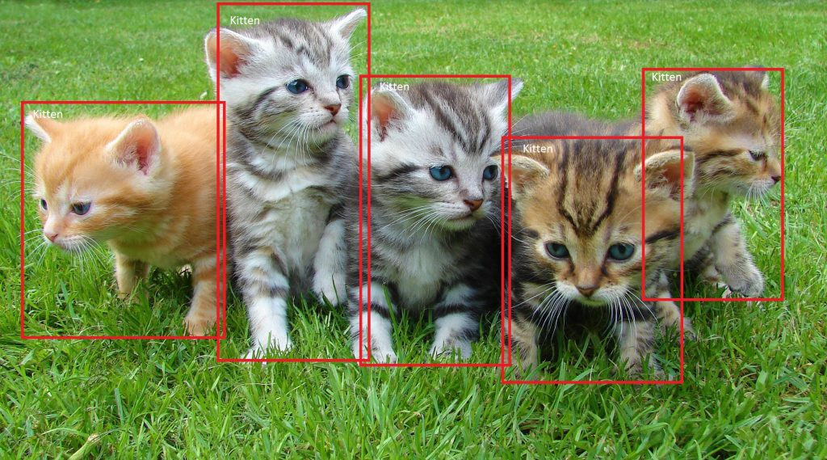
SSD: Single Shot MultiBox Detector 29 Dec 2016 UNC Chapel Hill, Zoox Inc., Google Inc. and University of Michigan, Ann-Arbor
Daniel Kovachev & Yuval Amrami
Example of end-to-end object detection in a Box (from Microsoft)

Slide 2
Problem Definition
Given an image as input
Predict bounding boxes and class labels for each object in the image.
Object Detection

Slide 3
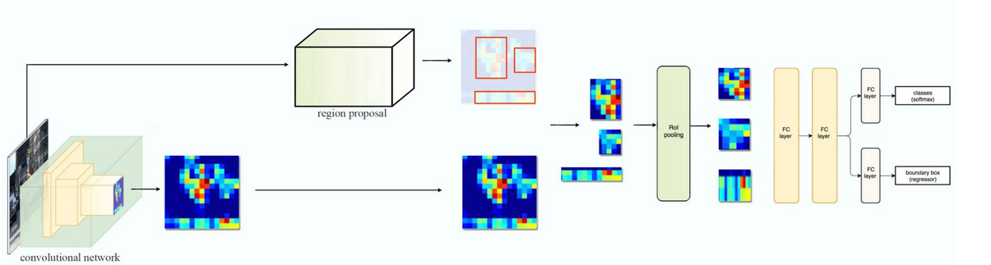
Fast R-CNN

Slide 4
Fast R-CNN Problems
Training phase is too long
Training happens in multiple phases (e.g. training region proposal vs classifier)
Network is too slow at inference time(2 seconds)

Slide 5
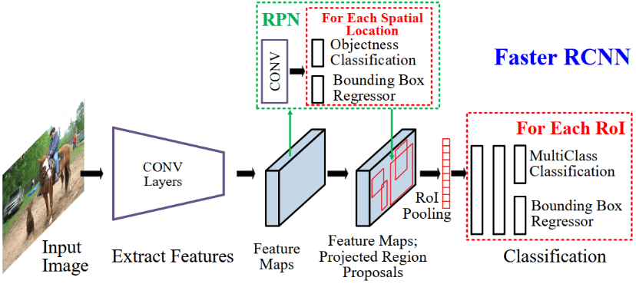
Faster R-CNN

Slide 6
Faster R-CNN Problems
Training phase is too long
Network is too slow at inference time (0.2 seconds)

Slide 7
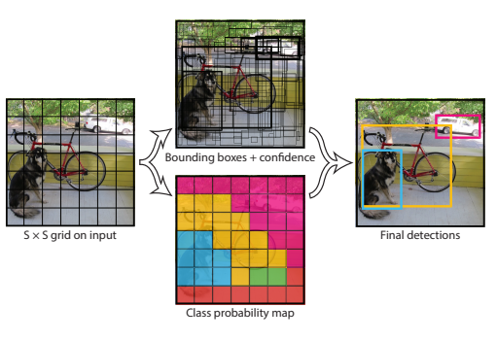
YOLO – You Only Look Once

Slide 8
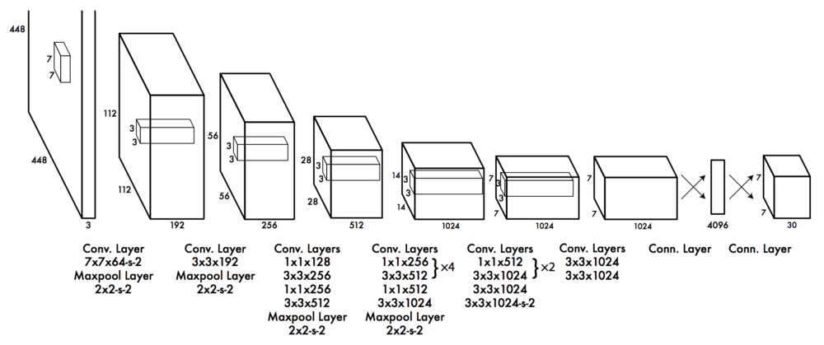
YOLO – You Only Look Once

Slide 9
YOLO Problems
Low Accuracy compared to Faster R-CNN.
Struggle with small objects.
Bounding boxes aren't optimal(Loss function)

Slide 10
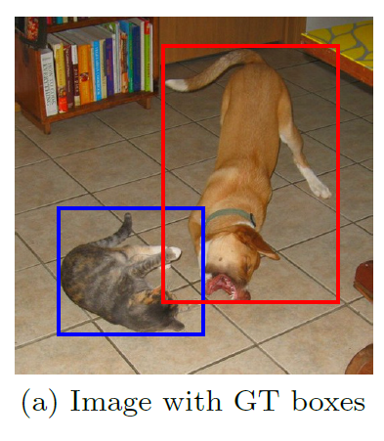
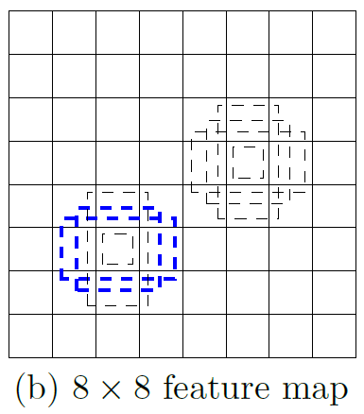
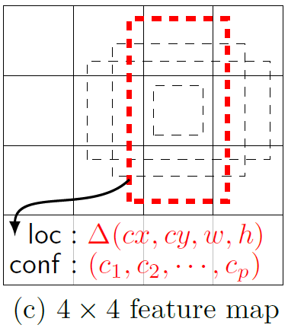
Single Shot MultiBox Detector
74% mAP (mean Average Precision) at 59 frames per second on standard datasets such as PascalVOC and COCO
Single Shot: The tasks of object localization and classification are done in a single forward pass of the network
MultiBox: the name of a technique for bounding box regression, developed by Szegedy et al.
Detector: The network is an object detector that also classifies those detected objects
(from SSD paper)

Slide 11
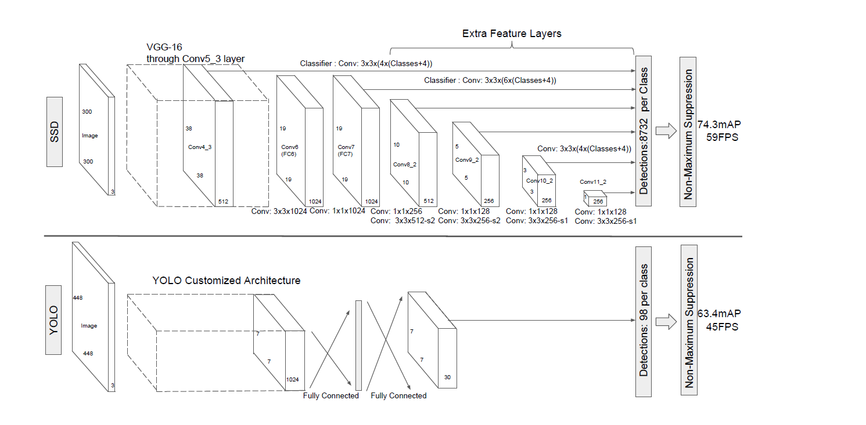
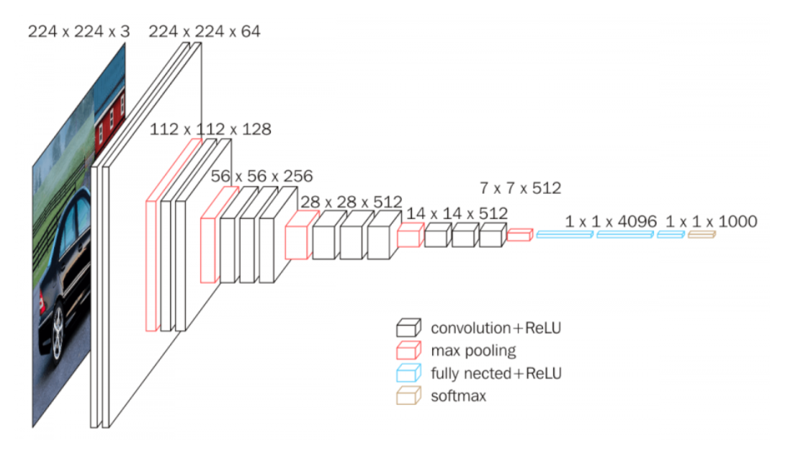
Architecture
SSD and YOLO architecture (from SSD paper)
VGG-16 architecture (from Neurohive)
Notes:
VGG-16 נבחרה בגלל יעילות אבל הופרדה משכבות מחוברות לחלוטין לשכבות עזר בממדים שונים

Slide 12
References
Understanding SSD MultiBox — Real-Time Object Detection In Deep Learning by Eddie Forson, Nov 18, 2017
Click to edit Bullet Point
Click to edit Bullet Point
Click to edit Bullet Point
Click to edit Bullet Point
Click to edit Bullet Point

Slide 13
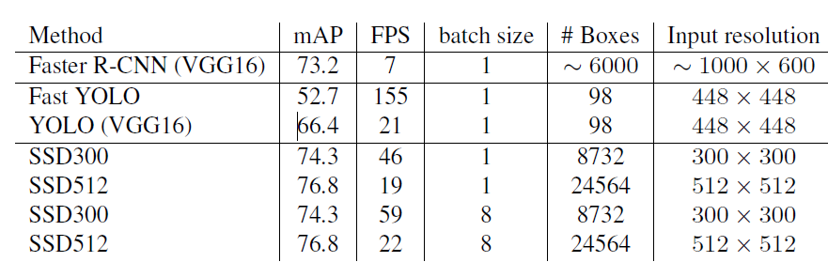
מה עוד
תהליך אימון?
סינון תוצאות עם כמות התאמות גדולה?
מתמטיקה?
תוצאות על המאגרים השונים?
תיאור של ההשוואה בין מולטי בוקס לSSD?
דוגמאות
נקודות תורפה שנשארו במערכת?
Click to edit Bullet Point
Click to edit Bullet Point
Click to edit Bullet Point
Click to edit Bullet Point
Click to edit Bullet Point

Slide 14

Thank you.

Slide 15
Text slide
Click to edit Bullet Point
Click to edit Bullet Point
Click to edit Bullet Point
Click to edit Bullet Point
Click to edit Bullet Point
Click to edit Bullet Point

Slide 16
Text slide
Subtitle
Click to edit Bullet Point
Click to edit Bullet Point
Click to edit Bullet Point
Click to edit Bullet Point
Click to edit Bullet Point
Click to edit Bullet Point

Slide 17

Text + Picture
Click to edit Bullet Point
Click to edit Bullet Point
Click to edit Bullet Point
Click to edit Bullet Point
Click to edit Bullet Point
Click to edit Bullet Point

Slide 18

Text + Picture 2
Click to edit Bullet Point
Click to edit Bullet Point
Click to edit Bullet Point
Click to edit Bullet Point
Click to edit Bullet Point
Click to edit Bullet Point

Slide 19

Text + Picture 3
Click to edit Bullet Point
Click to edit Bullet Point
Click to edit Bullet Point
Click to edit Bullet Point
Click to edit Bullet Point
Click to edit Bullet Point

Slide 20

Text + Picture 4

Slide 21
Graph slide

Slide 22
Graph slide
Click to edit Bullet Point
Click to edit Bullet Point
Click to edit Bullet Point
Click to edit Bullet Point
Click to edit Bullet Point
Click to edit Bullet Point
Graph title

Slide 23
Icon bank

Slide 24
Icon bank

